Slide 1
Palette-Based Photo Recoloring Midterm Demo
Brandon Cuadrado, 109237297
CSE 564, Spring 2018

Slide 2
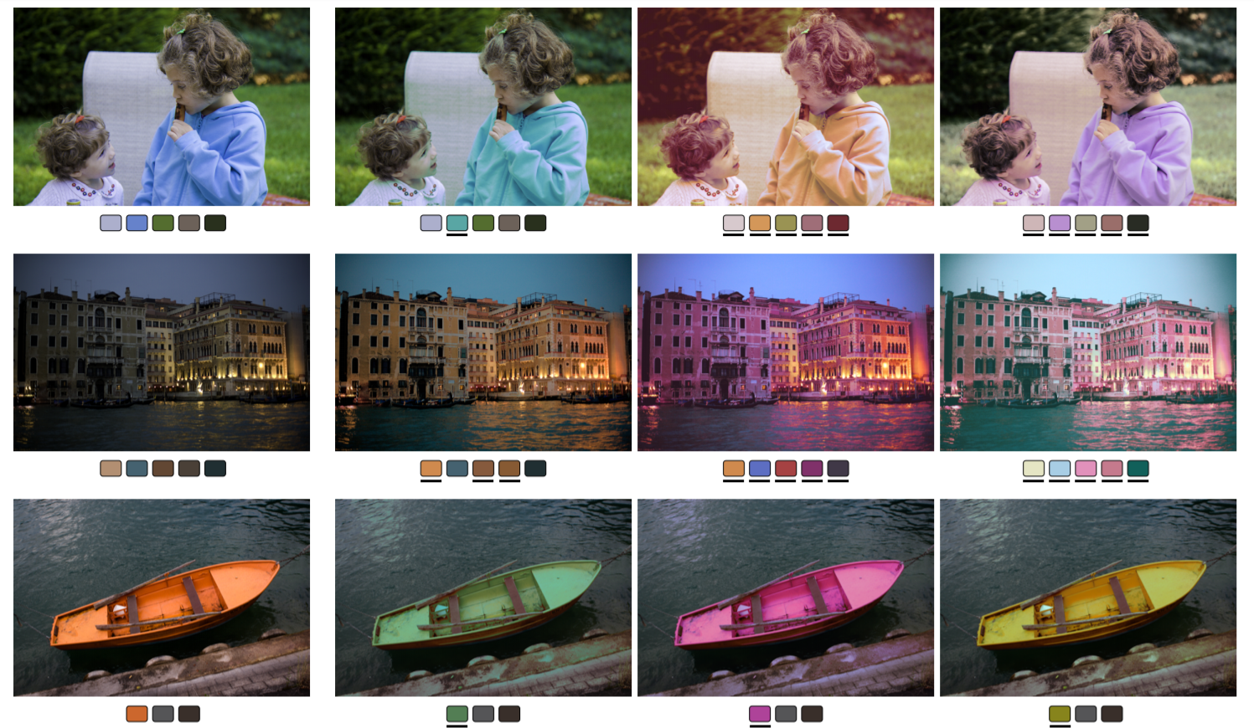
Palette-Based Color Transfer

Slide 3
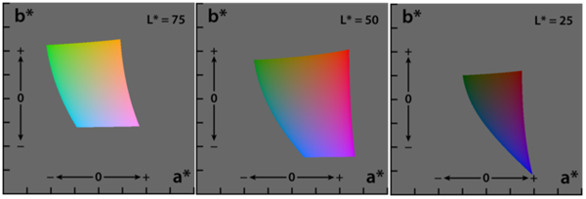
Lab Color Space
Image is displayed in an html canvas element.
This allows the RGB values of each pixel to be extracted using the getImageData() function.
These values will be converted to LAB Color Space for all computations
Notes:
LAB – Luminance, a, b
Plane has different a,b bounds based on luminance
Boundaries denote when color can no longer be represented by RGB
During color transfer, these boundaries will be used to weigh the effect of a color change on each individual pixel within a luminance value.

Slide 4
Automatic Palette Selection
A modified version of K-Means Clustering is used to generate the palette of an image
Get histogram of RGB values (0-255) among 16 bins each
Compute mean color in Lab Color Space for every bin
Perform K-Means Clustering on the 3*16 colors
With initial means selected by size of its bin
With 6th bin centered on the color black
Convert output back into RGB colors
Notes:
After finishing Color Transfer implementation
I may upgrade this algorithm to use 16^3 bins.
Separating the bins into 16 x 16 x 16, without overlap

Slide 5
Color Transfer
Simple color transfer would…
Organize pixels by cluster
Add the exact distance between old color and new color
Instead, for each pixel in the image…
For each color in the palette, add the distance with consideration to colors that will lie outside the RGB gamut
Apply a weight to each change in color and take the result of the sum of these changes

Slide 6
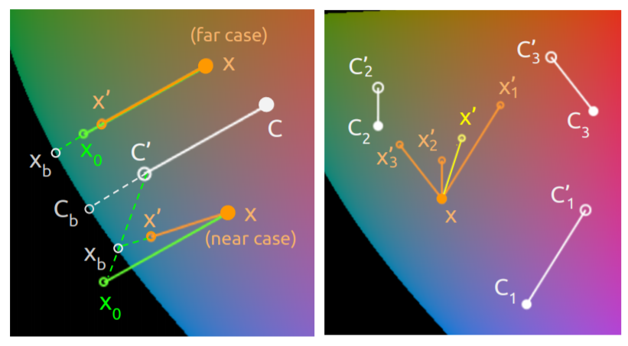
Color Transfer
Single Color Transfer
Weighted Color Transfer
Notes:
Each change is depicted on the left
This is done for every color in the palette
Far case is used when color is within gamut using exact distance
Near case is used when color is outside the gamut using exact distance
Final change based on weights is on the right
I am experimenting with different methods used to calculate the weights
My current implementation does not work due to improperly weights

Slide 7
Citations & JavaScript Libraries
Palette-based Photo Recoloring
[https://dl.acm.org/citation.cfm?id=2766978]
Clusterfck.js: K-Means Clustering
Color.js: Conversion between RGB and LAB color spaces
Jquery.js: UI interactivity
JsColor.js: Color Picker UI
Math.js: Linear Algebra and other arithmetic

Slide 8
Further Work
Updating Color Transfer weighing algorithm
Enforce Monotonic Luminance in UI and Color Transfer
Adjust user-submitted changes to palette to be within a range of L-values in Lab color space
This will allow for smoother changes and simpler calculations
Accelerate Color Transfer
Current method iterates through all pixels in a 400x400 image
Acceleration involves computing weights before color transfer, during color palette extraction. Among other methods.
Notes:
Other improvements:
Update calculations for determining gamut boundary intersection
Update histogram construction to include 16x16x16 bins to advance palette selection

